Slide 1
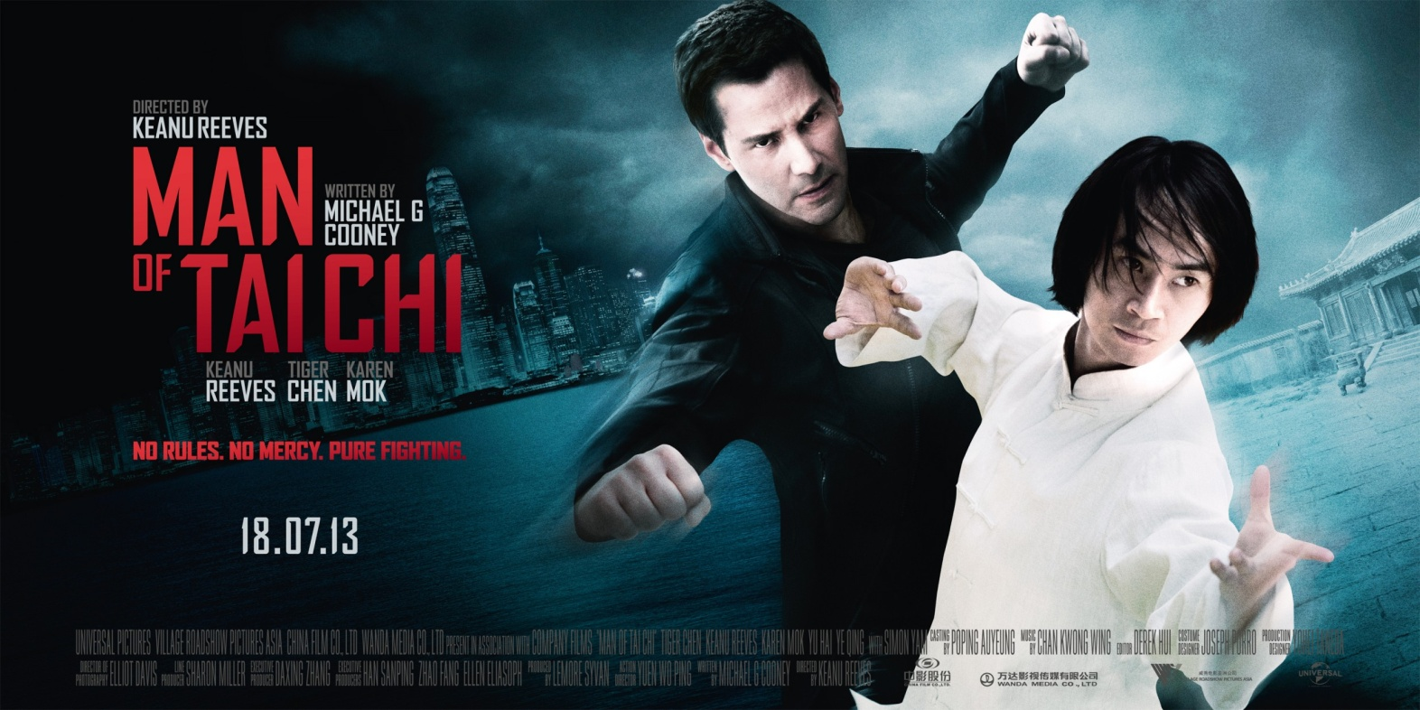
Professional training seminar on COPYRIGHT for film professionals
Nairobi, Kenya – April 1, 2, 2014
Case Study
MAN OF TAI CHI

Slide 2
Case Study – Man of Tai Chi
Careers Discussed in this Presentation
Producer
Creatives (Writer, Director, Actors, Music)
Lawyers
Distributors
Acquisition Executives
Marketing Staff
Lawyers
Co-Production Executives
Government Film Authorities Including Censors

Slide 3
Case Study – Man of Tai Chi
Trailer:
  US:
  http://movies.yahoo.com/video/man-tai-chi-trailer-220029923.html
  Chinese:
  http://badassdigest.com/2013/04/22/see-the-trailer-for-keanu-reeves-man-of-tai-chi/
In Keanu’s Own Words: http://www.youtube.com/watch?v=LdQRvmsbZbU

Slide 4
Case Study – Man of Tai Chi
Creative/Business/Finance Considerations
Assembling the Co-Production
Coordinating the Creative Elements
Financing the Project
Distribution Strategies

Slide 5
Case Study – Man of Tai Chi
Assembling the Co-Production
  Project Origin
    Original Story 2007 or 2008
    Decision to Develop/Scriptwriting
    Approach to Partners
    Importance of Creative Elements
      Director/Co-Star - Keanu Reeves - Canadian
      Writer – Michael G. Cooney - Irish
      Story/Characters - Chinese
      Tiger Chen (Chen Hu) – Chinese (HK)
      Karen Mok – Chinese (HK)
      Only American was the Director of Photography

Slide 6
Case Study – Man of Tai Chi
Assembling the Co-Production and Finance
  Approaching the Partners
    Village Roadshow Pictures Asia (about $5 million)
      Benefits
      Demands
    China Film Group (about $7.5 million)
      Benefits
      Demands
    Wanda Media (about $7.5 million)
      Benefits
      Demands
    Universal Pictures (about $5 million)
      Benefits
      Demands

Slide 7
Case Study – Man of Tai Chi
Coordinating the Creative Elements
Producer – Lemore Syvan
  Script
  Director
  Cast
  Production Design, Stunt Choreography, Music
  Location
    Problem with Chinese Censors related to corrupt police and underground fighting
    Scenes moved to Hong Kong

Slide 8
Case Study – Man of Tai Chi
DEVELOPMENT/PRODUCTION
2008
  Keanu Reeves, Yuen Wo Ping and Tiger Chen Start to Develop the Script – They Met Making THE MATRIX
  Originally Called “Tai Chi Tiger”
December 2011
  US$25 Million Financing Secured – Pre-Production Can Start
February, 2012
  Production Starts in Beijing and Hong Kong
105 Days Later
  Production Wraps

Slide 9
Case Study – Man of Tai Chi
FESTIVAL AND MARKETING STRATEGIES
April, 2013
  Trailer Premieres at Beijing Film Festival
  Keanu Reeves Promotes the Film There
May, 2013
  Keanu Presents Scenes From the Film at the Cannes Film Festival in France (US Rights Sold)
June/July 2013
  Keanu Reeves and Tiger Chen Promote the Film in China Before the Theatrical Release There
September 2013
  Film Premieres at the Toronto International Film Festival

Slide 10
Case Study – Man of Tai Chi
Distribution Strategies
  China – China Film Group and Wanda Media
    Released July 5, 2013
    1,600 Screens plus 161 IMAX Engagements
  Asian Theatrical Release (outside of China) – Village Roadshow Asia
  United States – RADiUS/The Weinstein Company – rights purchased at Cannes after select scenes are shown – deal closed by talent agency Creative Artists Agency:
    October 27, 2013 - Ultra VOD (Premium VOD)
    iTunes - $14.99 to Own or $6.99 to Rent (48 hours) HD Only
    Amazon – HD - $12.99 to Own or $7.99 to Rent (48 hours)
    SD - $9.99 to Own or $6.99 to Rent (48 hours)
    Theatrical Release November 1 – 110 Cinemas
  Rest of World – Universal Pictures

Slide 11
Case Study – Man of Tai Chi
RESULTS
Chinese Box Office – US$5 million
  About $2 million in “receipts” less release costs – probably a net negative result from the theatrical release in China.
United States Ultra VOD - $1.5 million
  Distributor probably received about $1 million
  #7 on xBox; #10 on iTunes; #15 cable VOD
United States Box Office - $100,000
  Almost no net receipts after significant costs – at least a million dollars in release costs – probably more.
Rest of World – Unknown – many territories have not released

Slide 12
Case Study – Man of Tai Chi
RESULTS
THIS WAS FAR BELOW EXPECTATIONS

Slide 13
Case Study – Man of Tai Chi
RESULTS
Who Made Money?
  Keanu Reeves/Production Team and Actors
  Chinese Cinemas
  Accountants/Lawyers/Production Service Providers in China
Who Lost Money?
  U.S. Distributor (RADiUS/The Weinstein Company)
  China Film Group and Wanda Media
  Universal Pictures
  Village Roadshow Pictures Asia

Slide 14
Case Study – Man of Tai Chi
RESULTS
Who REALLY Lost Money?
NOT the Employees of
  U.S. Distributor (Radius/The Weinstein Company)
  China Film Group and Wanda Media
  Universal Pictures
  Village Roadshow Pictures Asia
PROBABLY Stock Holders, The Chinese Government, China’s Richest Man (Wang Jianlin head of the Dalian Wanda Group), Investors in The Weinstein Company

