Slide 1
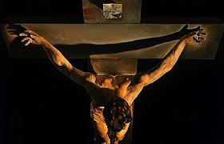
Renforcement du Secteur audiovisual au senegal atelier de formation des avocats
Saly, Senegal – 13 et 14 mars 2015
Case Study: Revenue Tracking
CRUCIXION

Slide 2
Case Study – CRUCIFIXION
Distribution Contract Financial Terms:
  The Advance Minimum Guarantee will be recouped by the Distributor from Licensor’s share of revenues.
  Theatrical: From theatrical revenues (rentals) - 35% fee to Distributor until recoupment of Recoupable Distribution Costs (P&A). P&A recouped from 65%. After recoupment of P&A rentals split 50/50. If any P&A is not recouped from theatrical revenues then it is recouped from Licensor’s share of future revenues.

Slide 3
Case Study – CRUCIFIXION
Distribution Contract Financial Terms:
  Home Video/DVD:
  - Rental Units Sold: Net billings (with no expenses deducted) shared 25% to Licensor and 75% to Distributor.
  - Sell-Thru Units Sold: Net billings (with no expenses deducted) shared 12.5% to Licensor and 87.5% to Distributor.
  TV (including Pay-Per-View, Pay TV and Free TV): 30% fee to Distributor with the balance 70% to Licensor with no deductions.

Slide 4
Case Study – CRUCIFIXION
Questions:
What amount of money has been paid to the Licensor?
What was the initial advance minimum guarantee payment?
What were the theatrical revenues?
What were the theatrical release costs?
In what currency were the revenues earned?
In what currency is the revenue being reported?
What are the most important facts in this distribution statement that should be checked against the distribution terms in the distribution agreement?

